Slide 1
PRACTICAL IMPLEMENTATAION OF AWS SERVICES PRESENTED BY -K.SUCHITRA DEVI(20A31A1209)

Slide 2
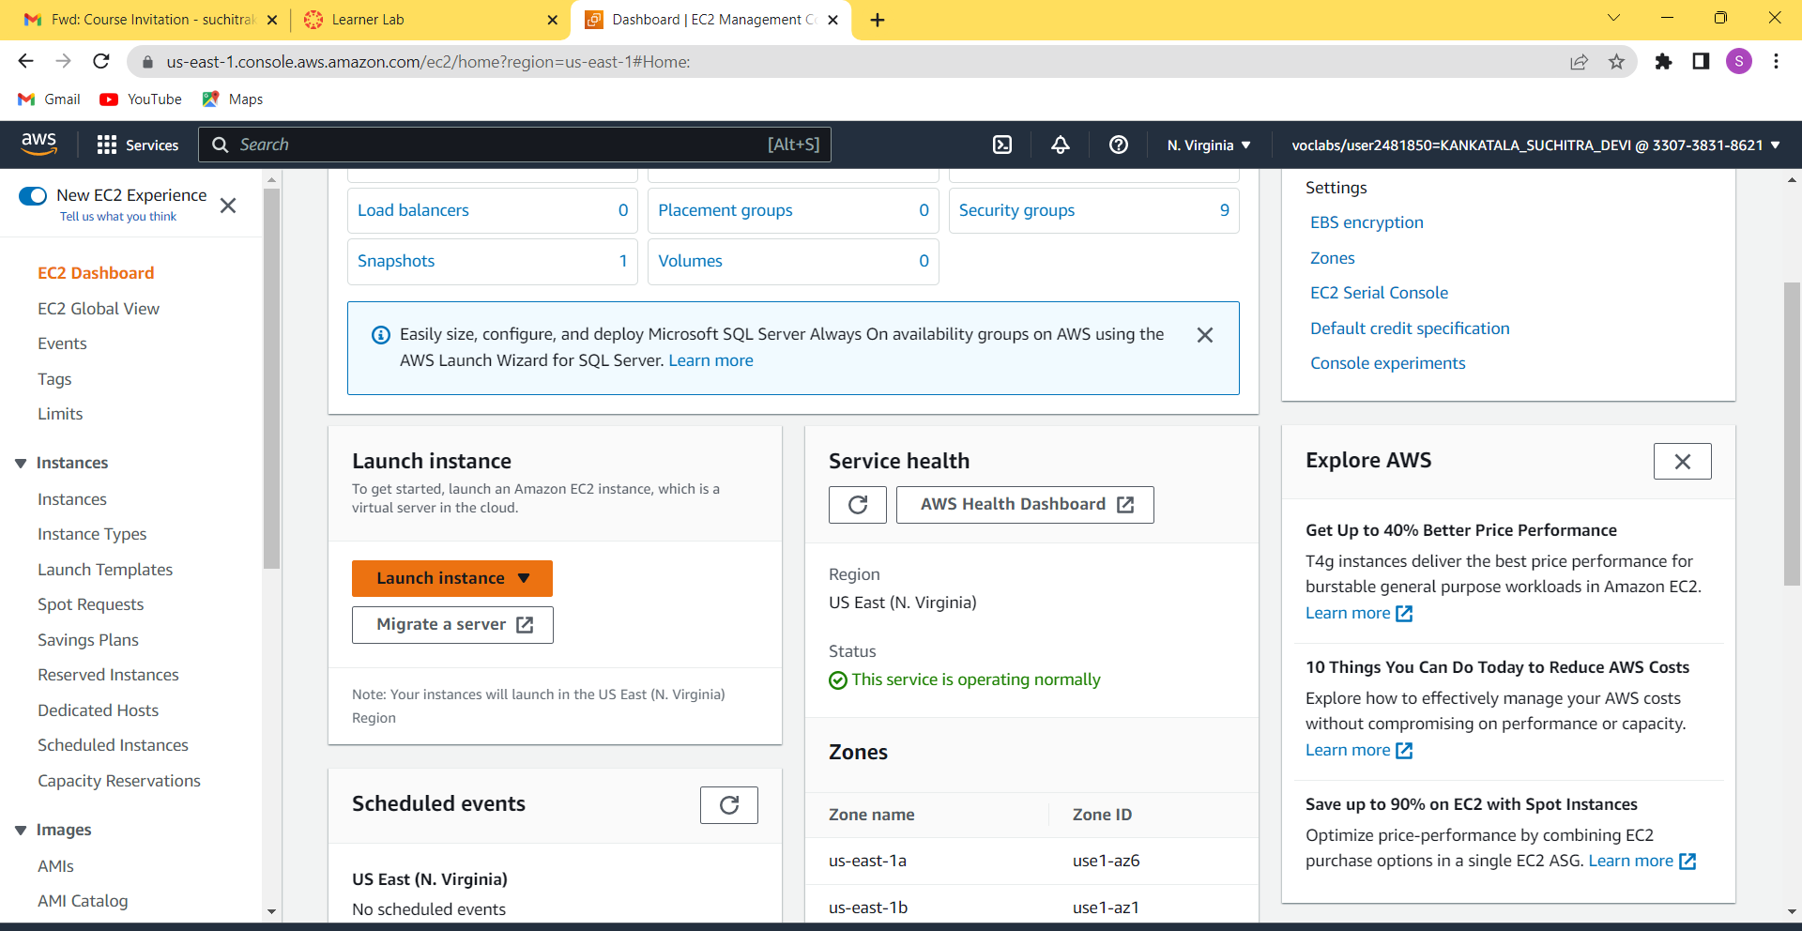
EC2 INSTANCE: STEP1:start the lab and then open AWS management console .select ec2 instance and click on the launch instance.

Slide 3
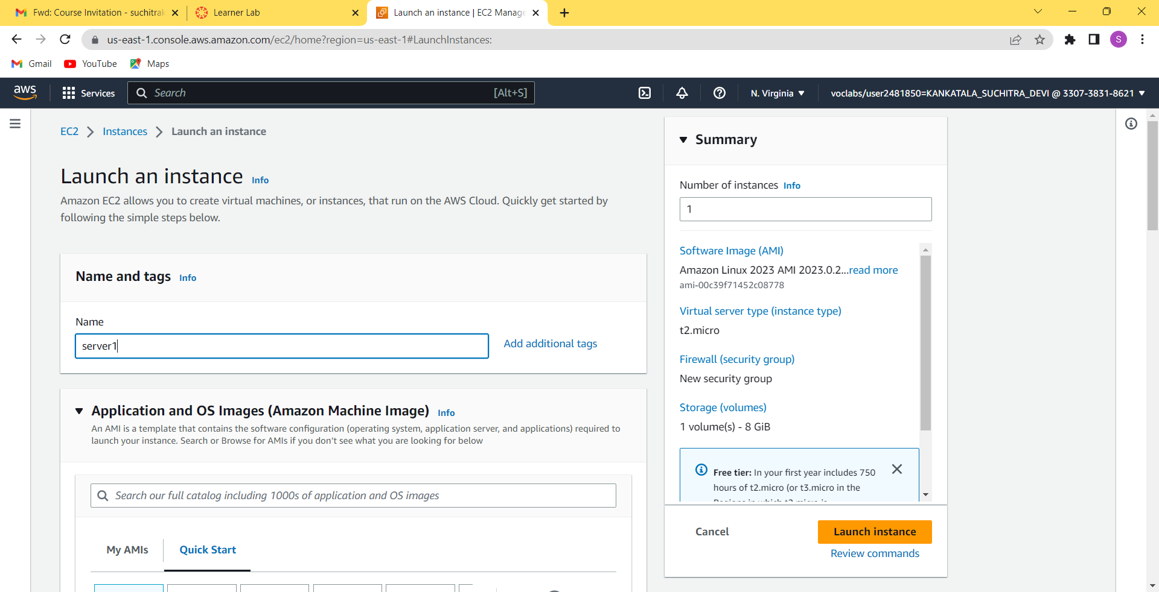
step2: after launching the instance name the instance.

Slide 4
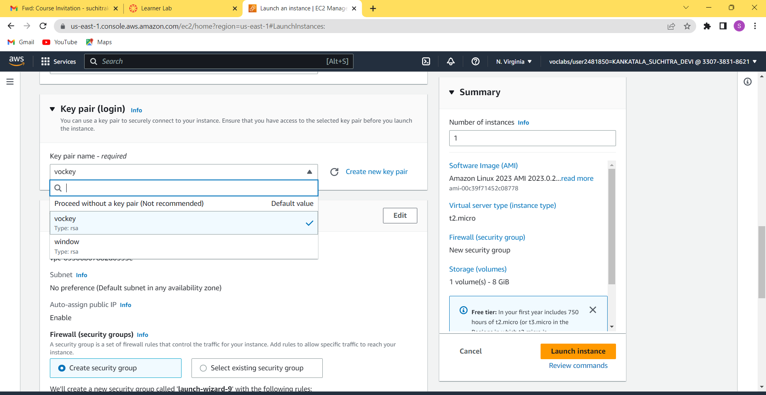
Step3: select the key pair as vochey.

Slide 5
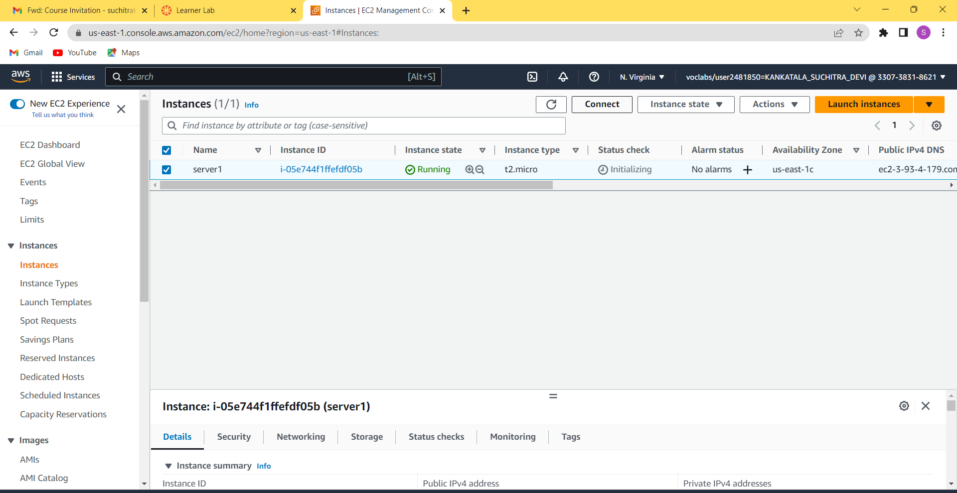
Step5:select the instance created and click on connect .

Slide 6
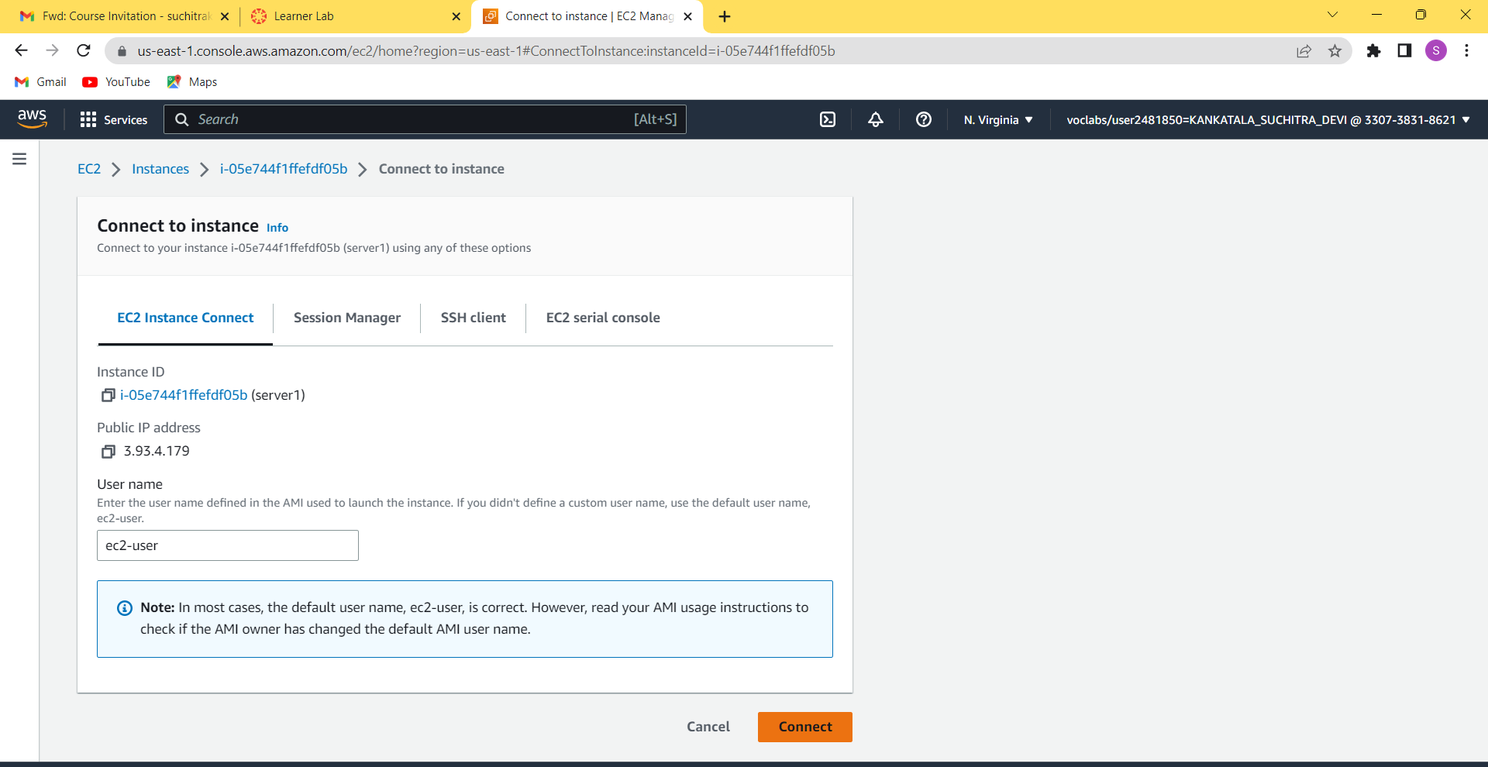
Step6: select connect option in the ec2 instance.

Slide 7
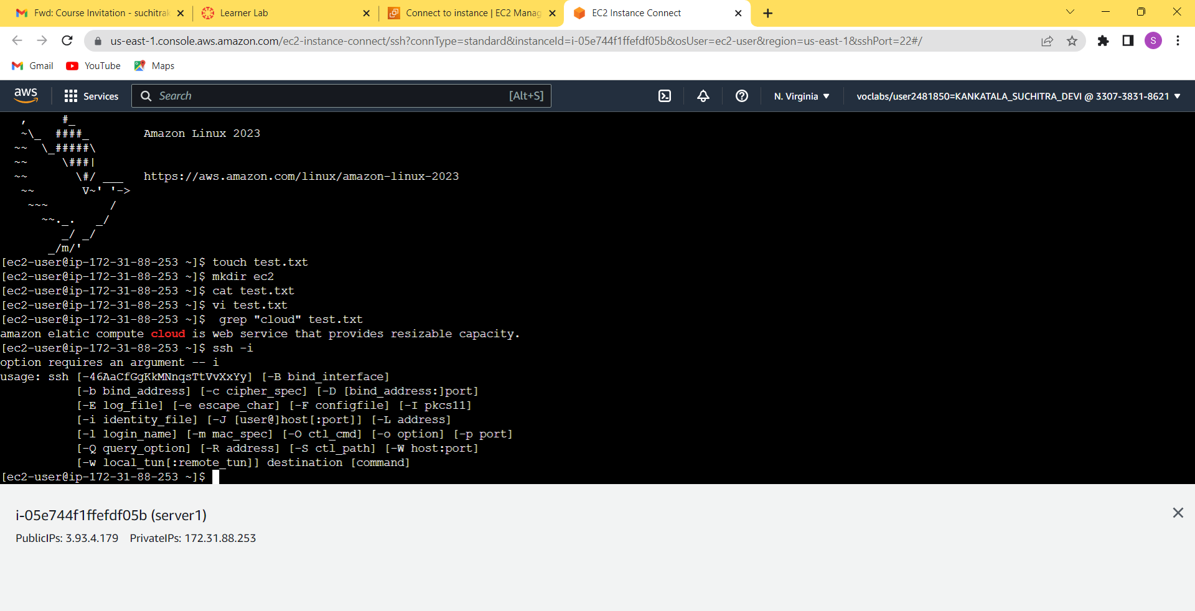
Step7:ec2 connect is opened and an eagle pic is displayed that it is connected successfully.

Slide 8
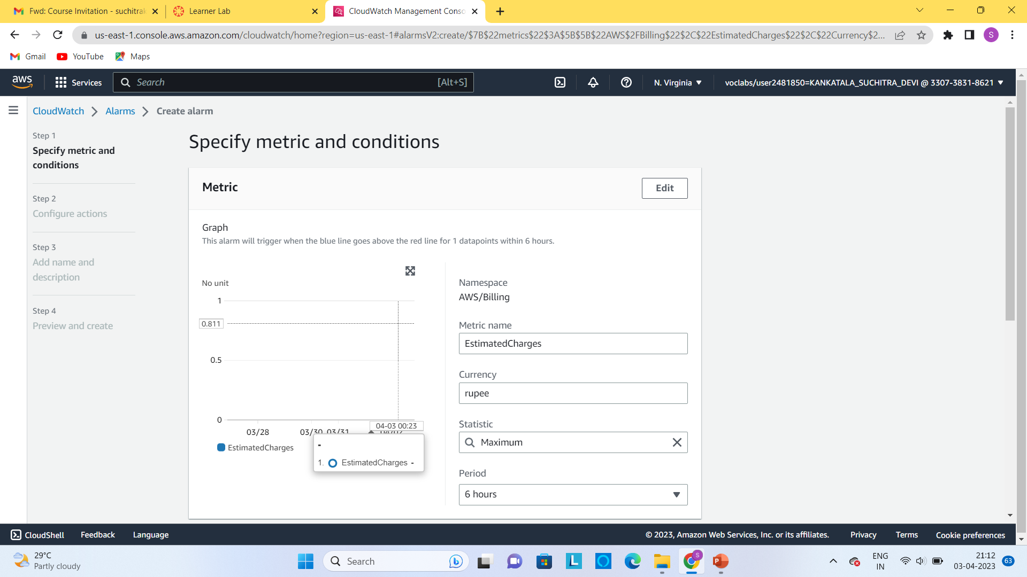
CLOUDWATCH: step1:select cloud watch in the aws management console, in the cloudwatch select billing and click on the create alarm .and then specify the metric contain currency as rupee and also the condition enter some amount.

Slide 9
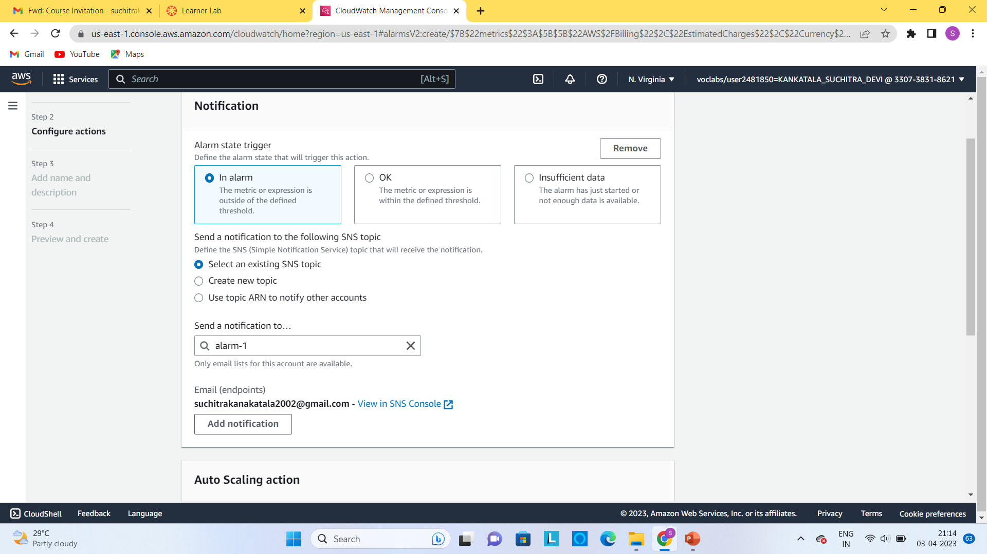
Step2:in the notifications column select the in alarm and then select a create a new topic in it name the alarm and mail endpoints to be noted .

Slide 10
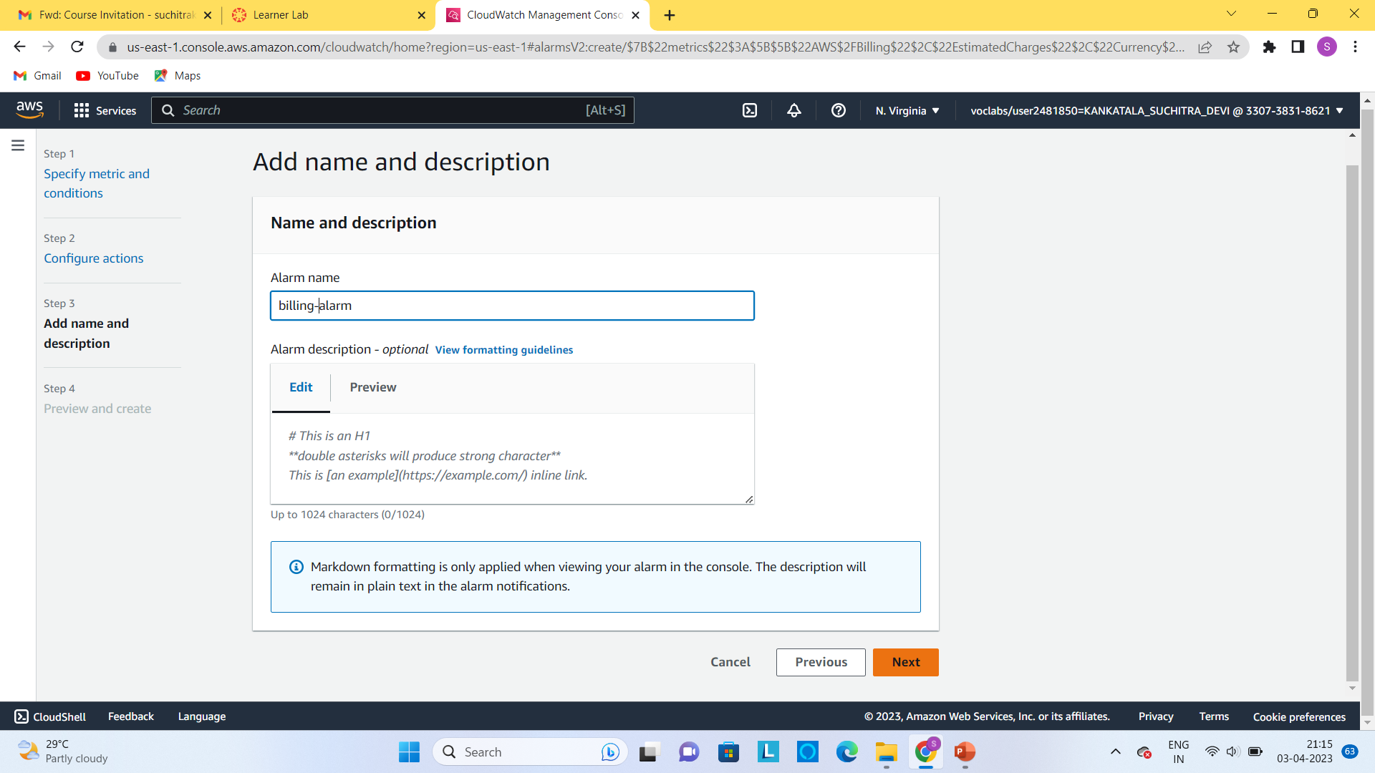
Step3:name the alarm and next ,create the alarm.

Slide 11
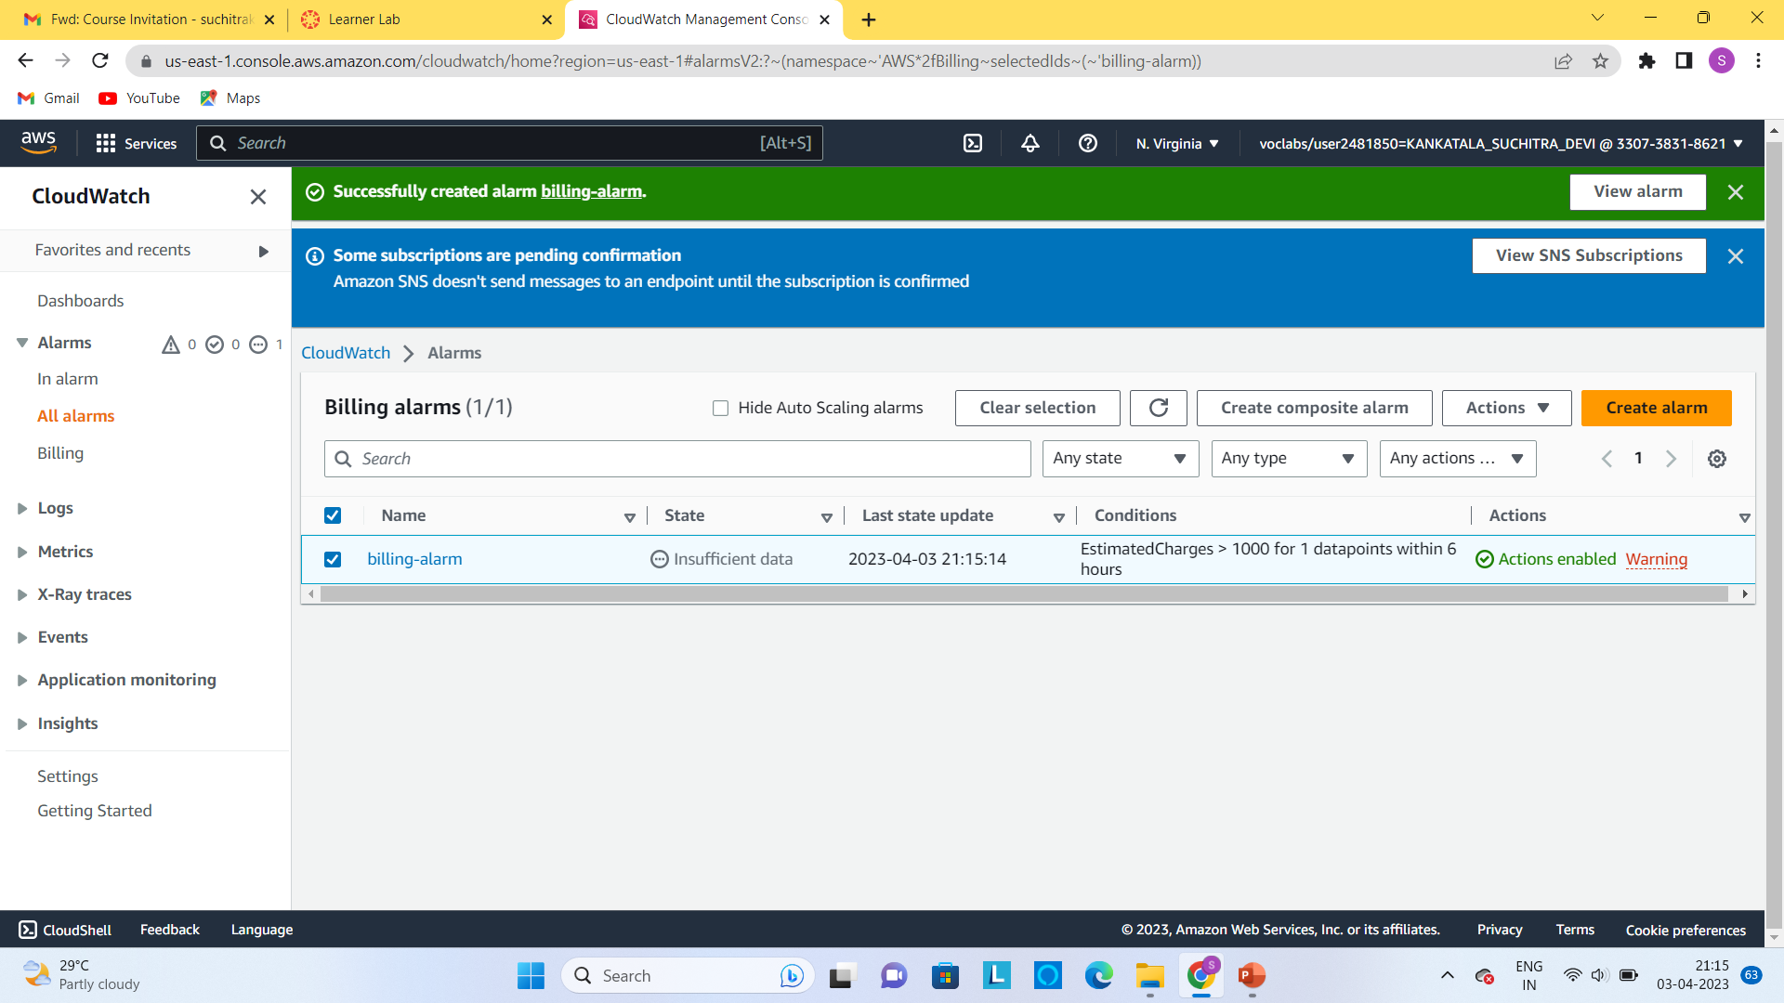
Step4:Billing alarm is successfully created.

Slide 12
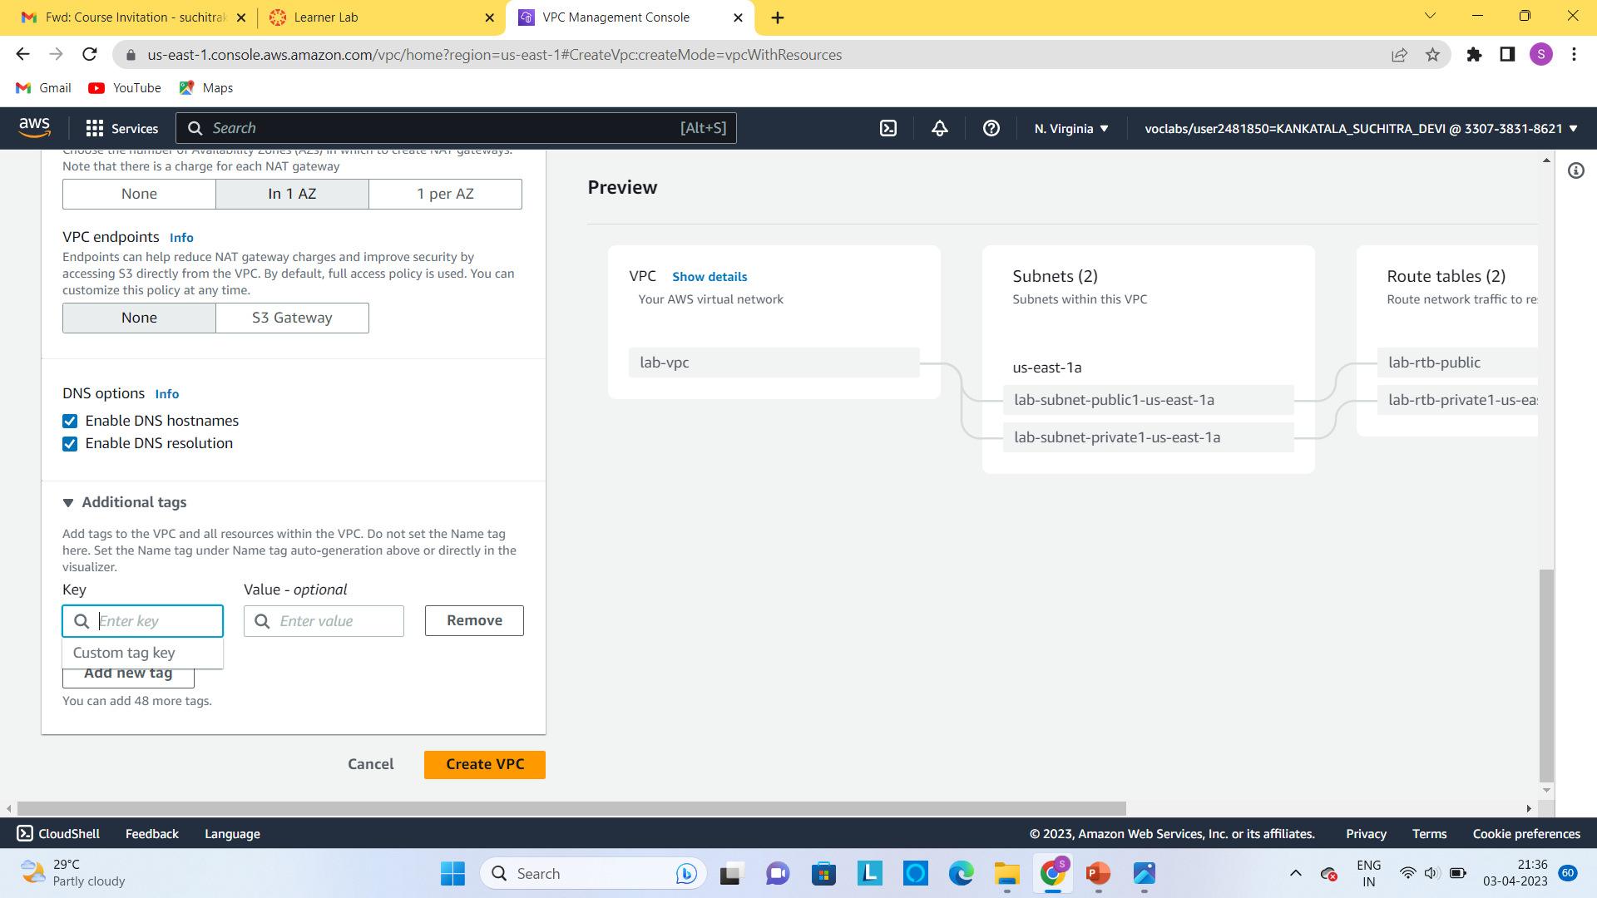
VPC(VIRTUAL PRIVATE CLOUD): step1:create a VPC network by configuring the details given in the console.

Slide 13
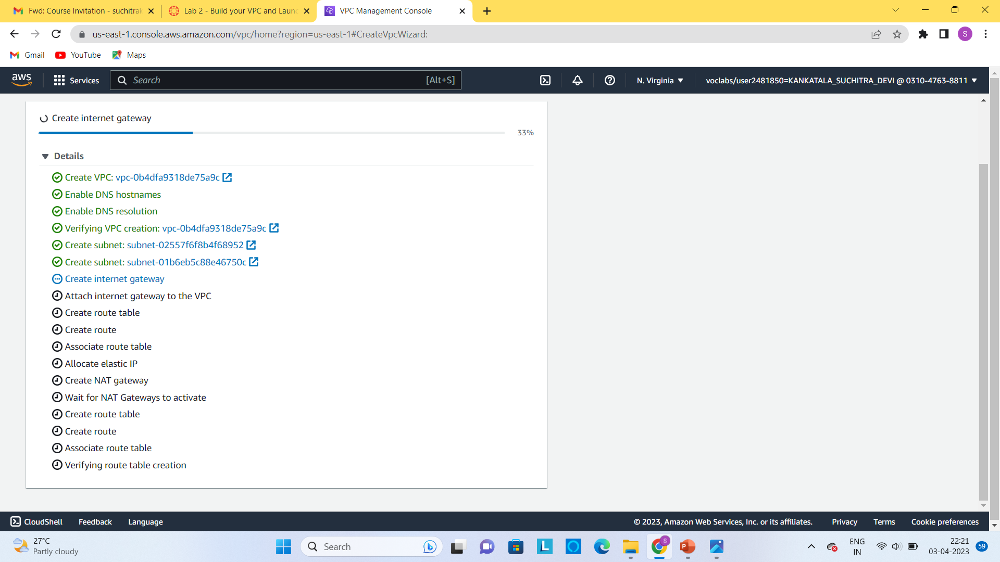
Step2:creation of VPC is successfully done.

Slide 14
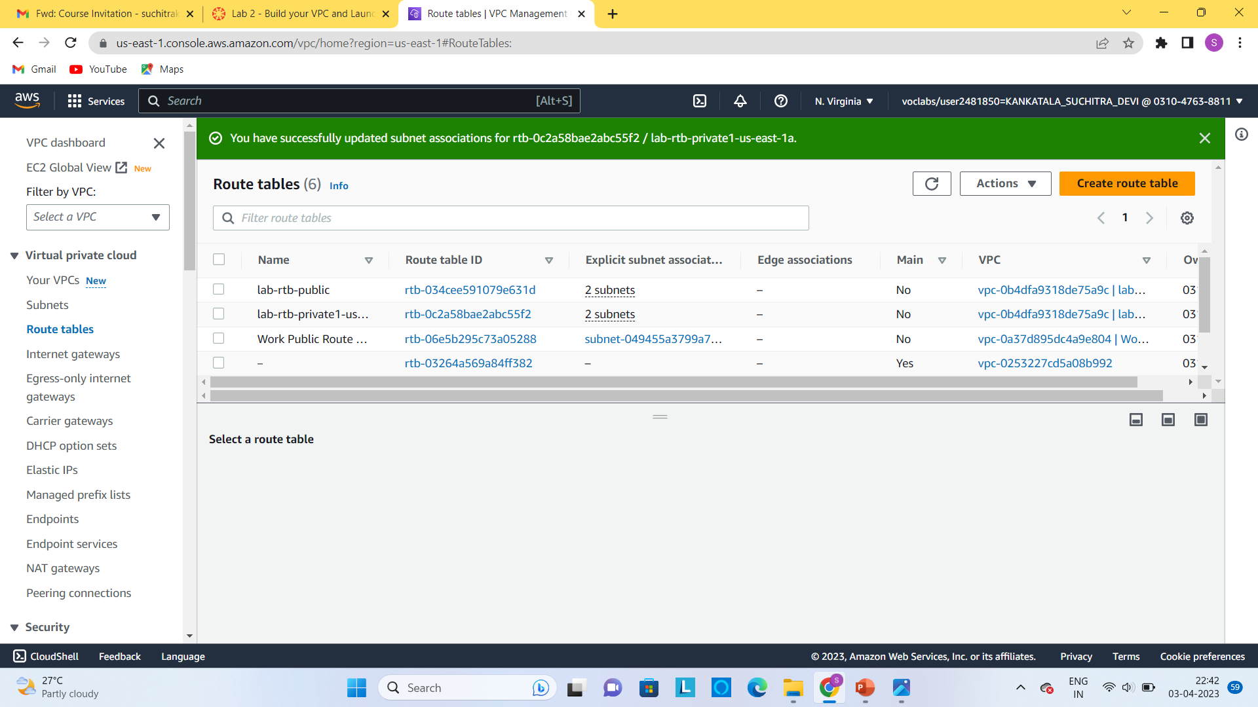
Step3:in the route table create association between the same type of cloud like private with private and public with public.

Slide 15
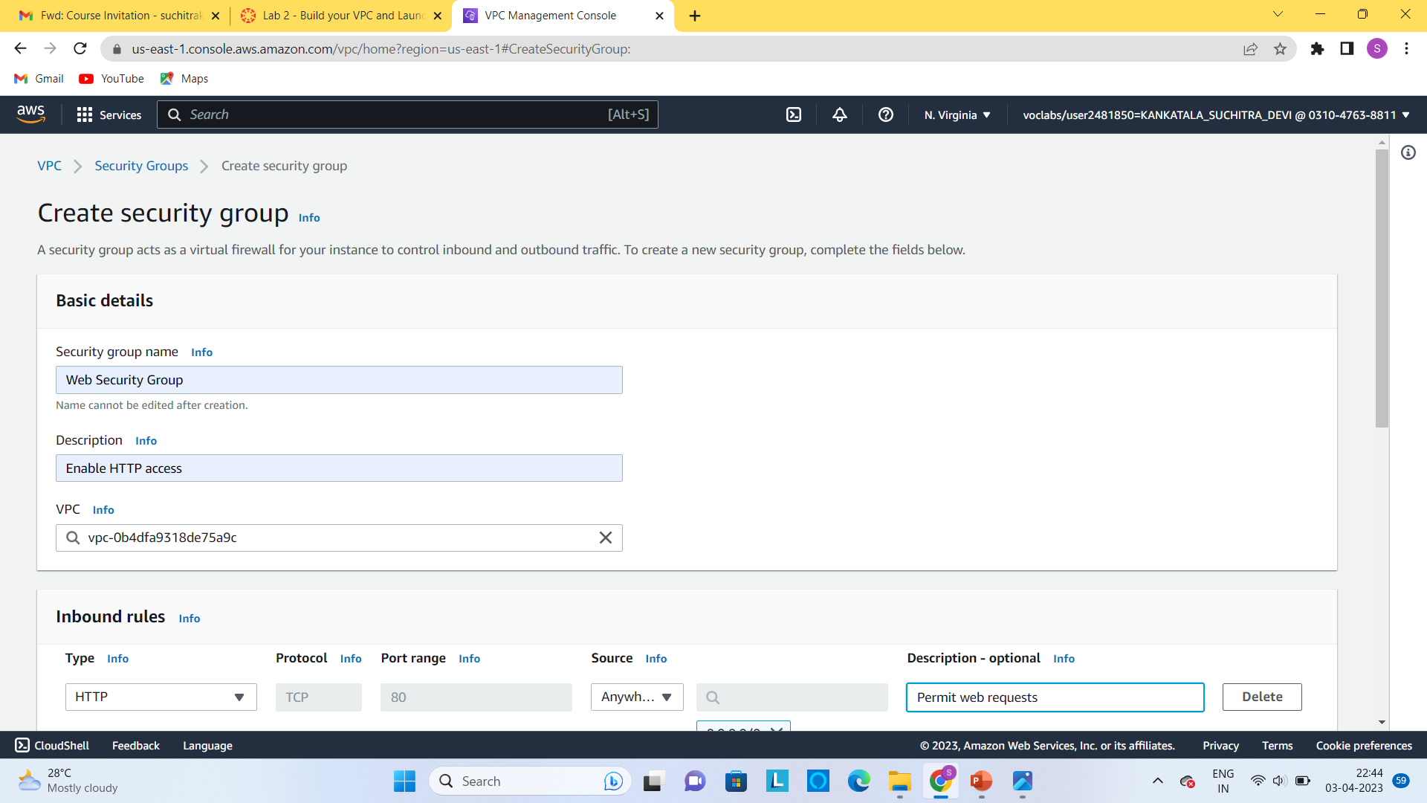
Step4:create a security group with name and description and add rule on the outbound and select type as http and source as anywhere ipv4, then create a security group

Slide 16
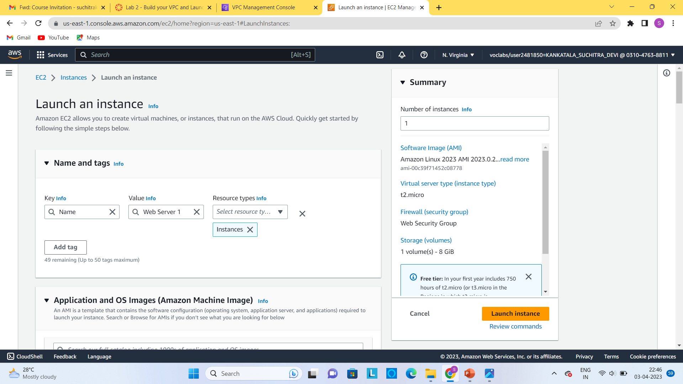
Step5:launch an instance using ec2 and add the required configuration to it and then launch an instance . and after launch the server wait until the health status is complete .

Slide 17
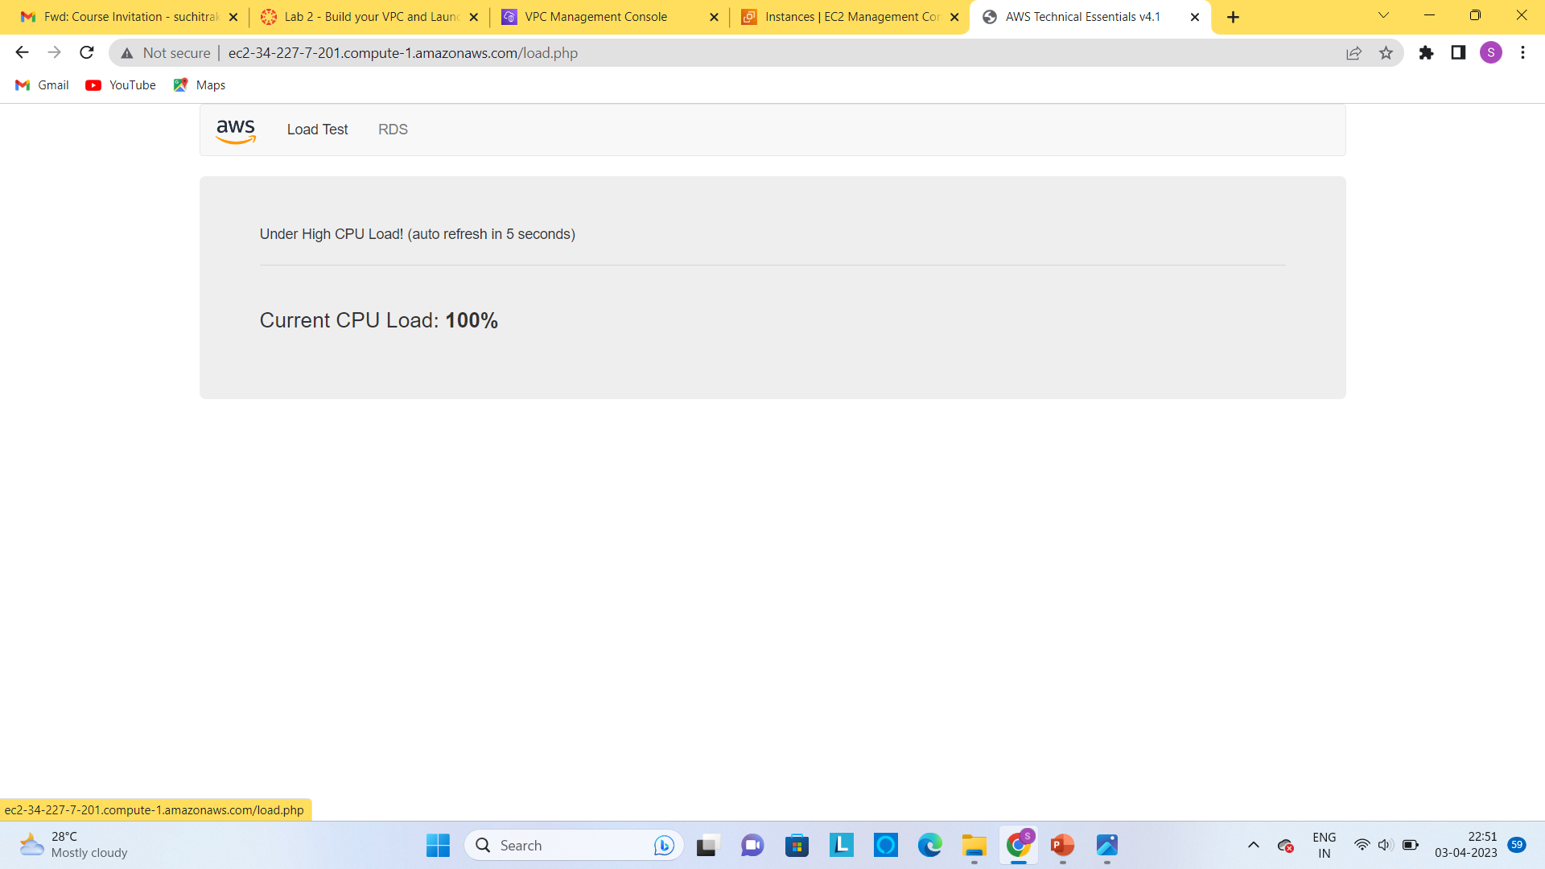
Step6:copy the public DNS and open in the new browser and then click on the load test wait until the load test reaches the 100%.

Slide 18
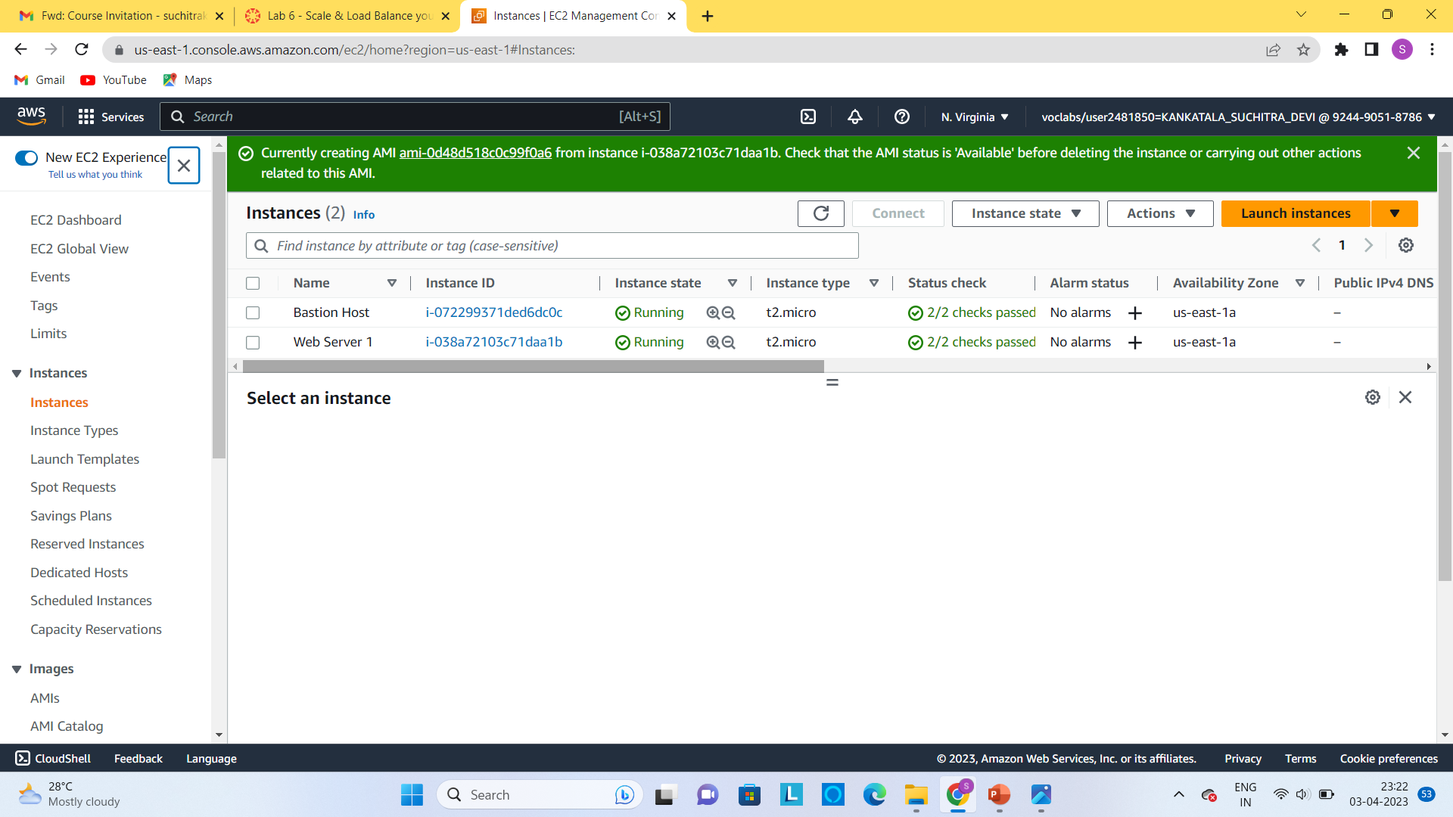
ELB(ELASTIC LOAD BALANCER): step1:launch an ec2 instance

Slide 19
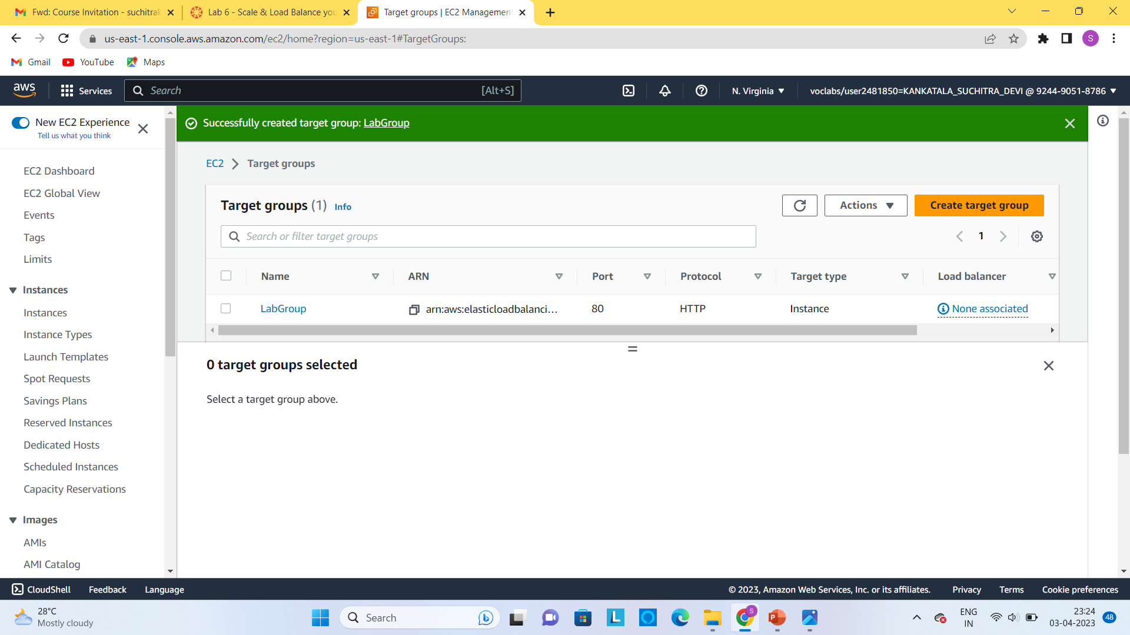
Step2:the required target group with given configurations is created.

Slide 20
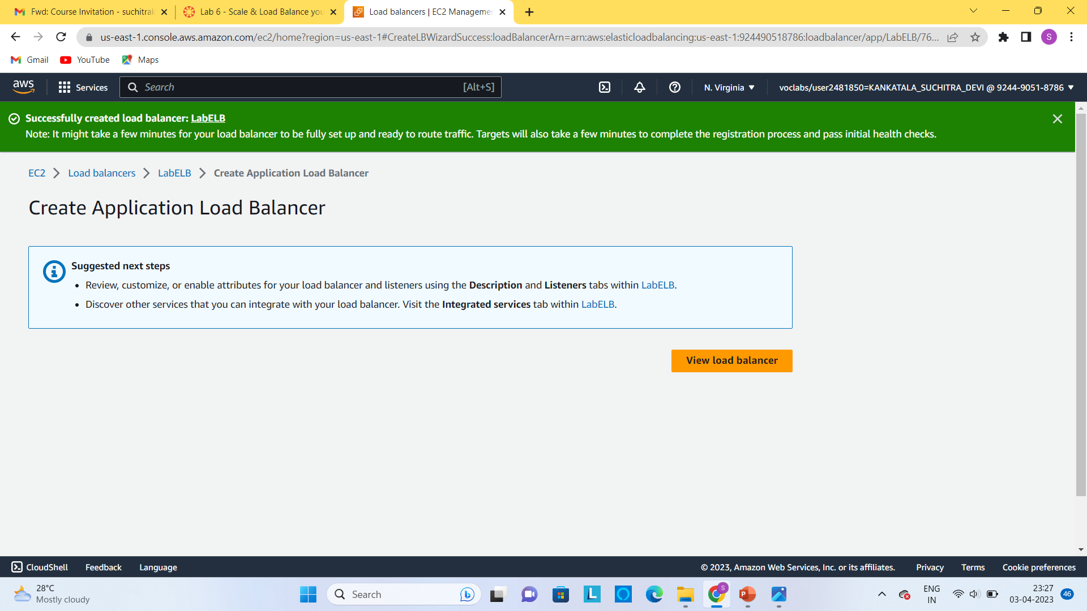
Step3:load balancer is successfully created with the labelLB .

Slide 21
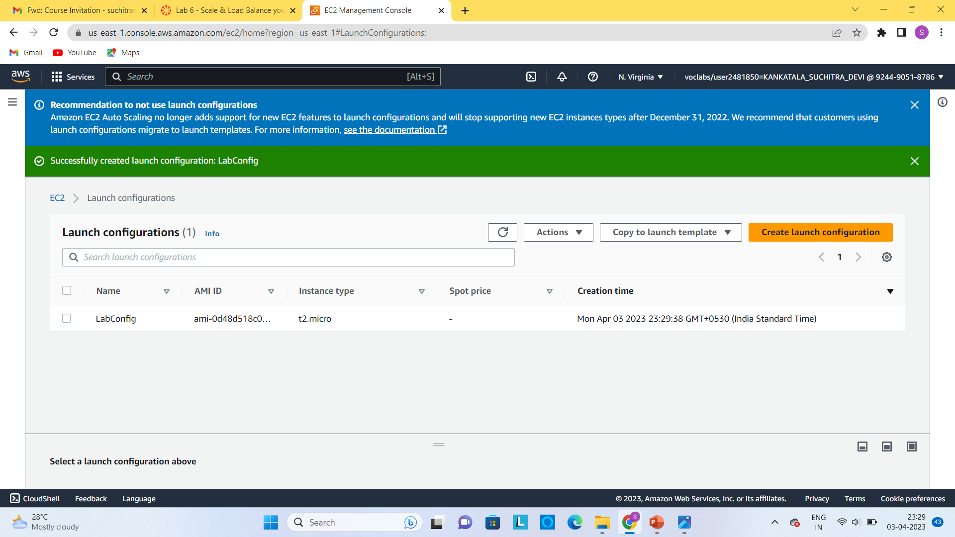
Step4:ec2 contains launch configuration by using this we can also create an autoscaling to it .

Slide 22
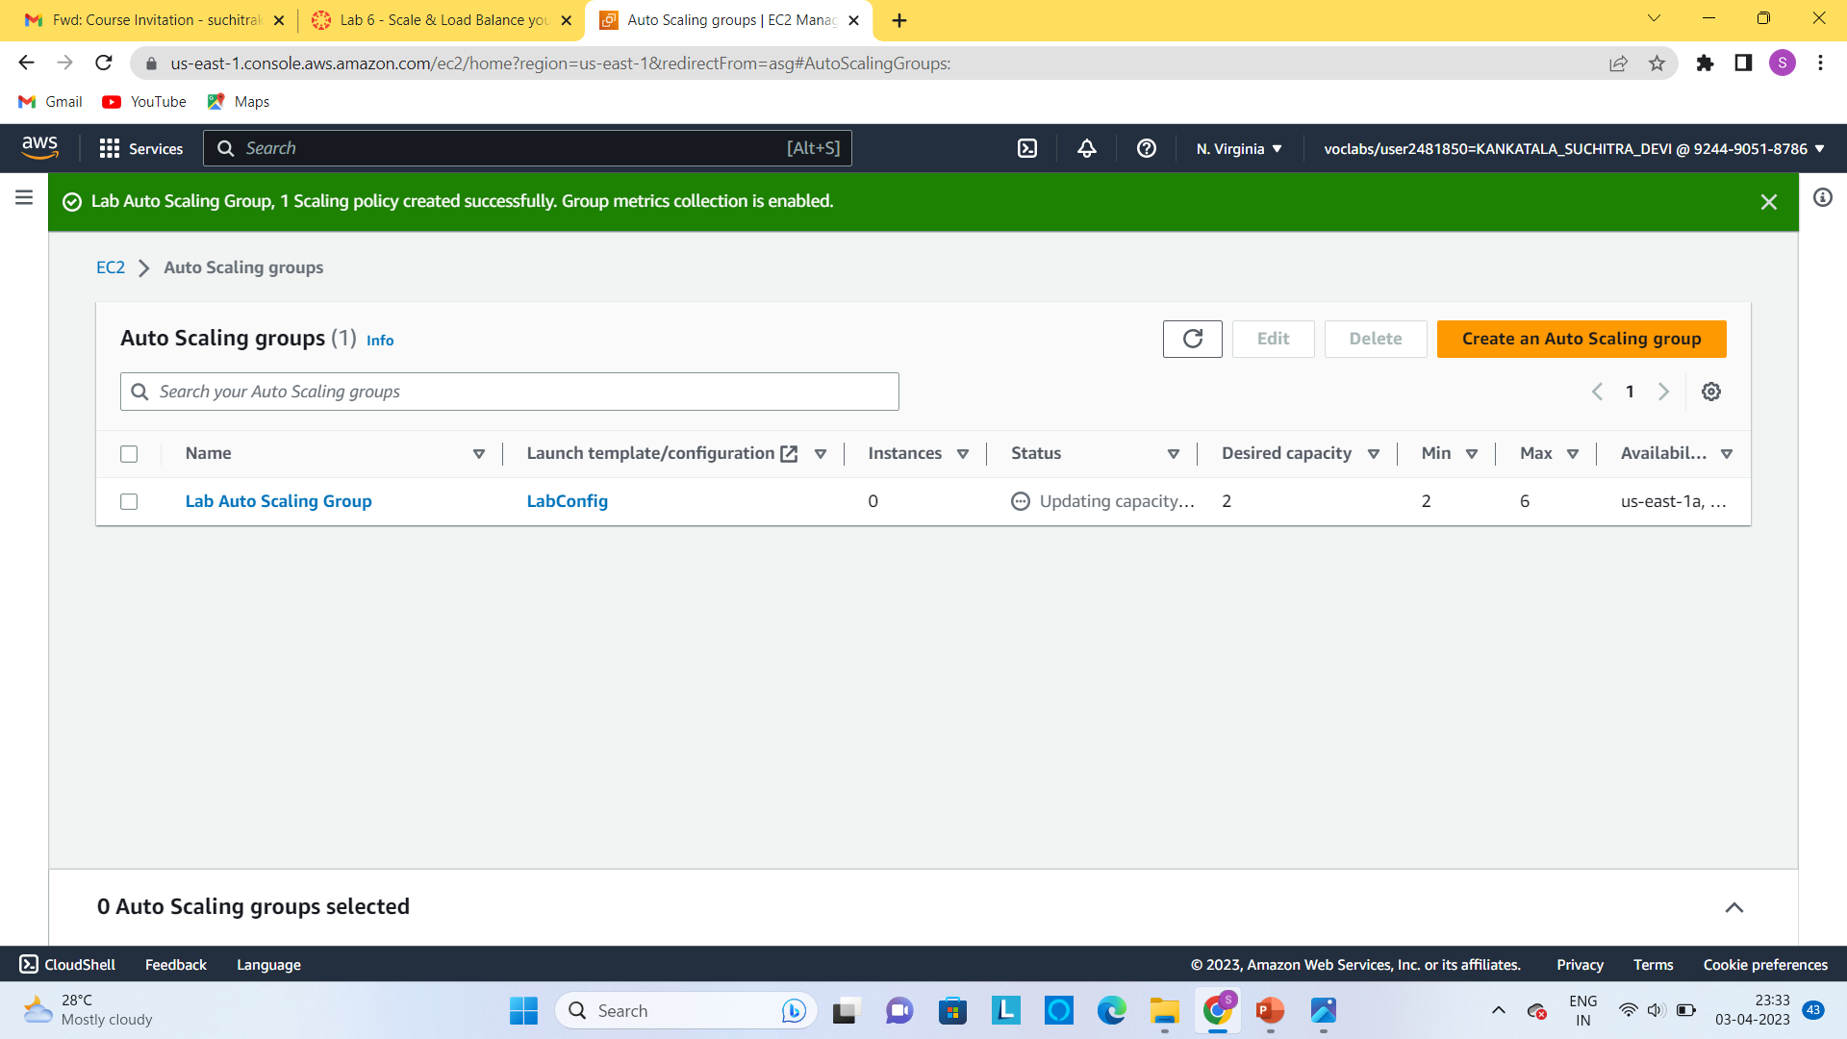
Step5:autoscaling group is successfully created .

Slide 23
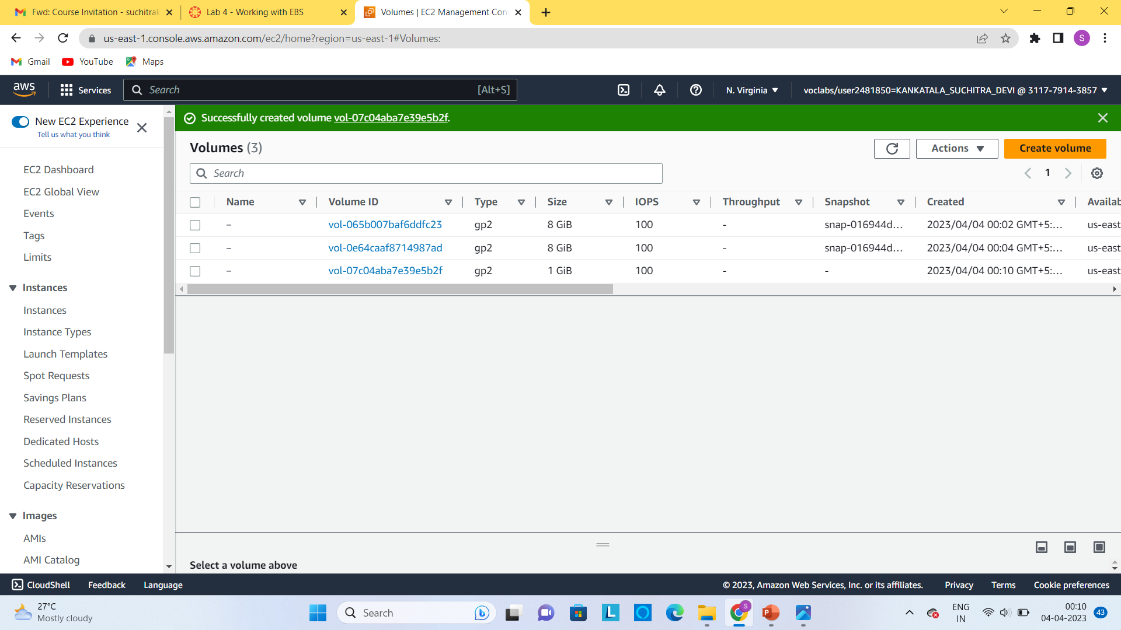
EBS(ELASTIC BLOCK STORE): Step1:In AWS management console select the volume column and then create avolume with specified type ,ssd , size, availability zone.

Slide 24
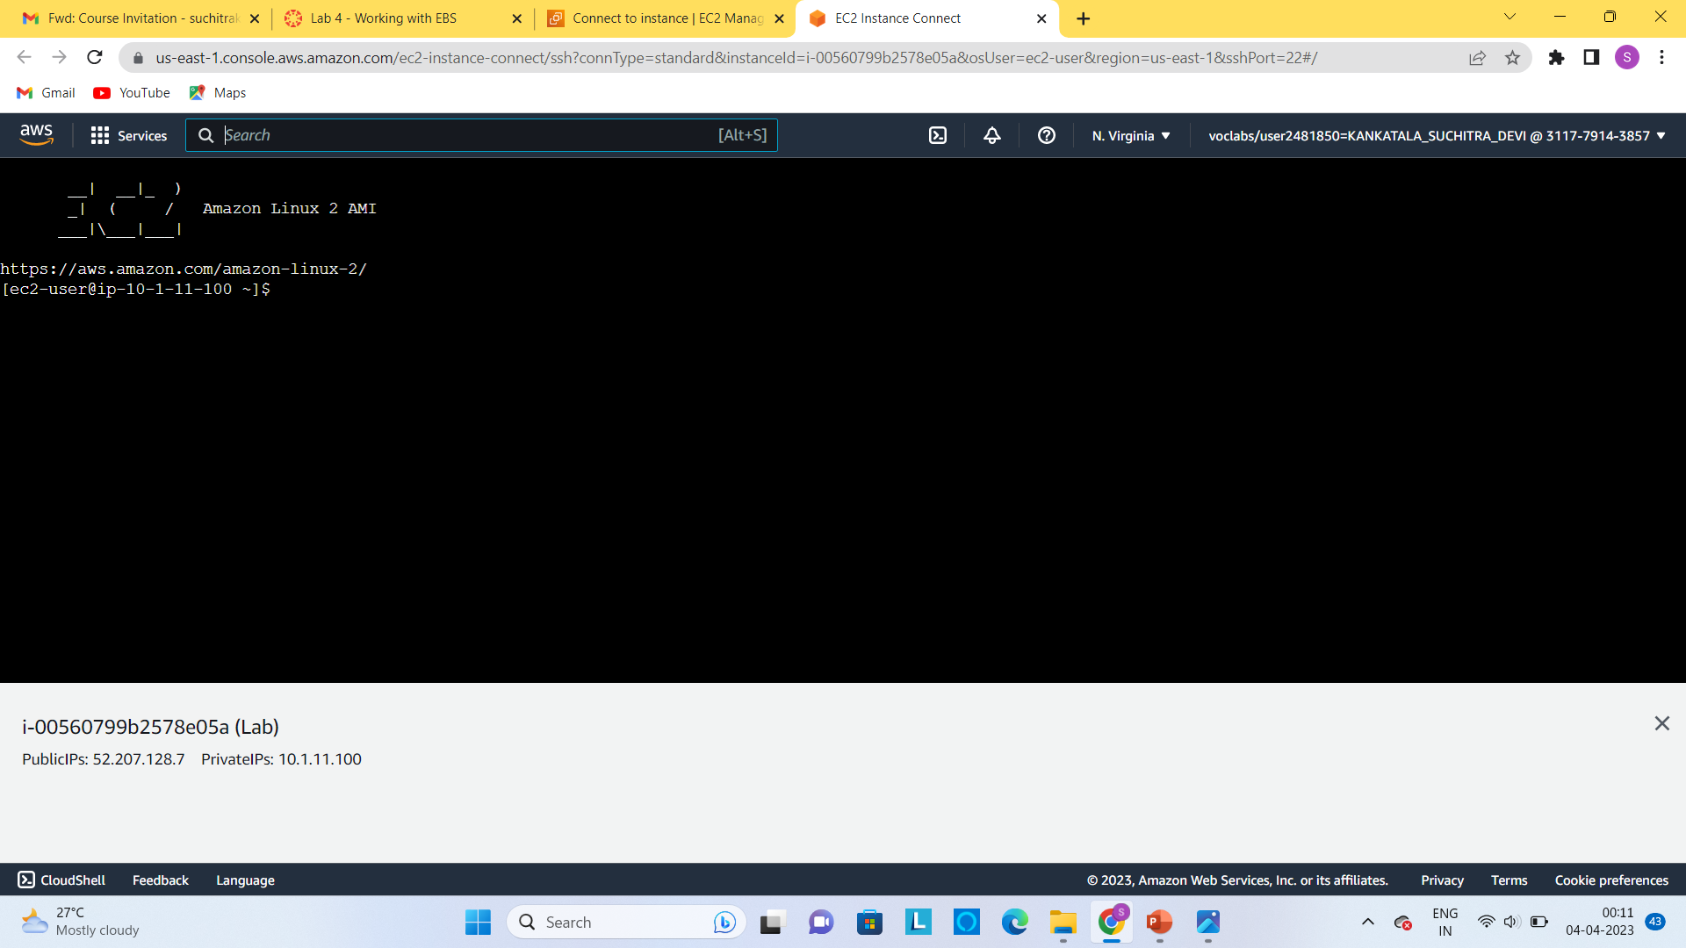
Step2:now attach EBS volume to an ec2 instance by clicking on the actions and selecting attach volume . and then connect through the ec2 instance a cloud shell is displayed.

Slide 25
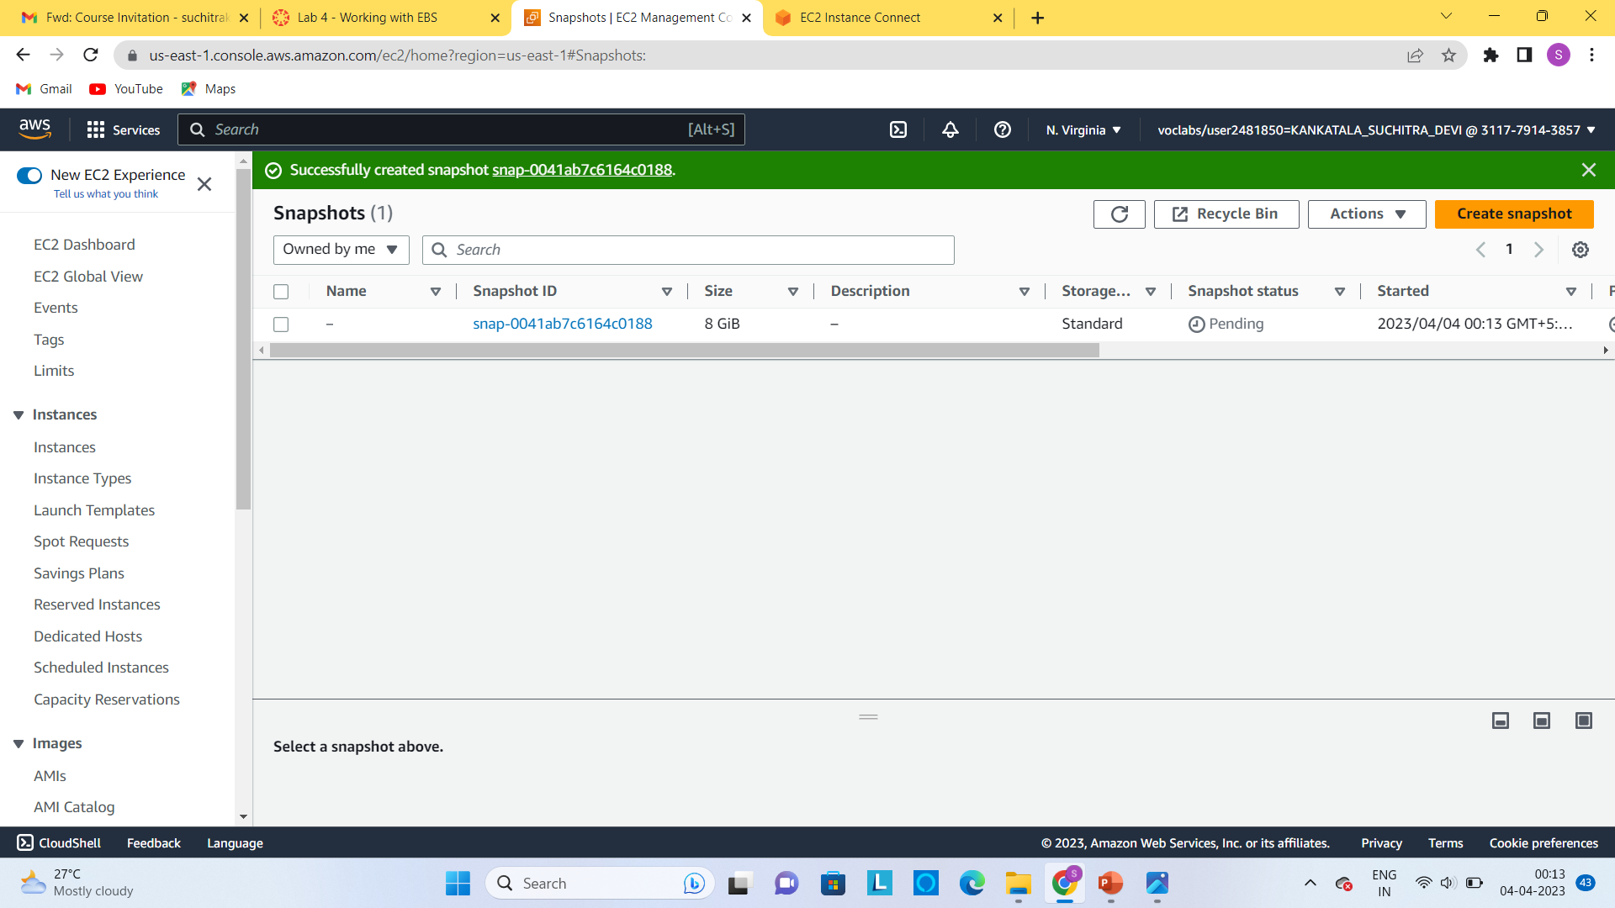
Step3:now create a snapshot to the EBS volume which is useful to backup.

Slide 26
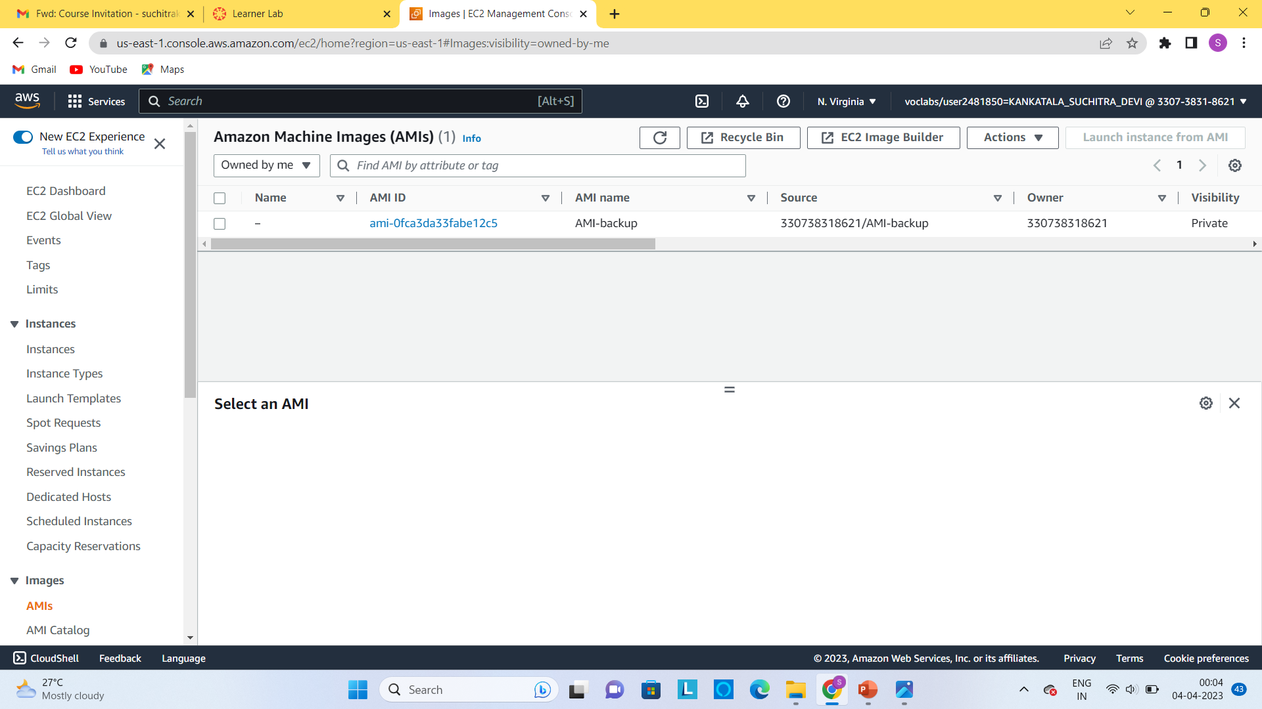
AMI(AMAZON MACHINE IMAGE): step1:launch an ec2 instance and then stop the instance . Step2:select the instance and click on actions then image and template from that select an create image. Step3:select the name and launch the instance .

Slide 27
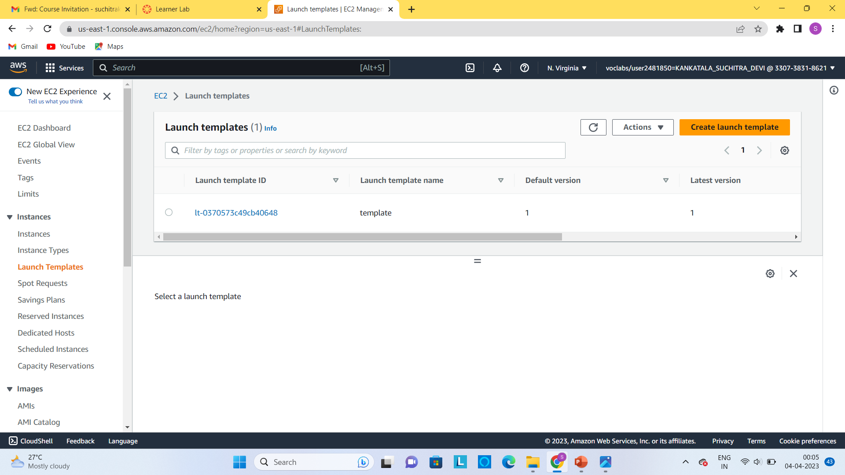
LAUNCH TEMPLATE: Step1:In AWS management console select the ec2 instance and then go to launch template select the configuration for the template and then create the template.

Slide 28
IAM(IDENTITY ACCESS MANAGEMENT):
In the AWS management console select the IAM.
Then in the navigation menu select the users.
Select the security credentials .
In the navigation pane select the user groups and then select the permissions tab..
Choose the plus icon next to the policy or permissions then select the permission that you assign.
In the IAM we have no authorized access to perform lab.

Slide 29
CLI(COMMAND LINE INTERFACE):
In amazon CLI open the command prompt and type aws configure space.
Then it asks the access key and secret access key.
Go to IAM services and from the users menu copy the access key and secret access key.
Then paste them in cloudshell and few more permissions are and required and complete the permissions .
Then you can access the CLI.

